Slide 1

Knowledge Preserving Remaining Useful Life Prediction based on Convolutional Neural Network

Slide 2
Purpose
Q: What’s your opinion we use CNN for automated feature extraction. I mean we can put raw signals (V, I, T) to CNN and the features will be extracted automatically. And then we use graph method to predict RUL.
A: I don’t advocate of automated feature extraction methods.
Problem
The data is limited, there are only about 124 batteries in the dataset. We will have many questions when using CNN. How to separate data? How many steps we will need to predict the next step? How to deal with the noise?
I have tried some automated encoding methods, such as transformers. The experiment result is awful, the neural network doesn’t converge.

Slide 3
Feature Extraction
Q: Didn’t you use current and voltage to extract the features?
A: I haven’t use current and voltage till now.
For current, once I thought as the dataset was generated by using controlled charging method, so the current data doesn’t matter much.
For voltage, to keep things simple, I use the Vdlin to derive dQdV and dTdV, which means the voltage doesn’t change across cycles.
But after consideration last night, I think I find too simple. The SOC-OCV curve will have play some roles in the prediction part.

Slide 4
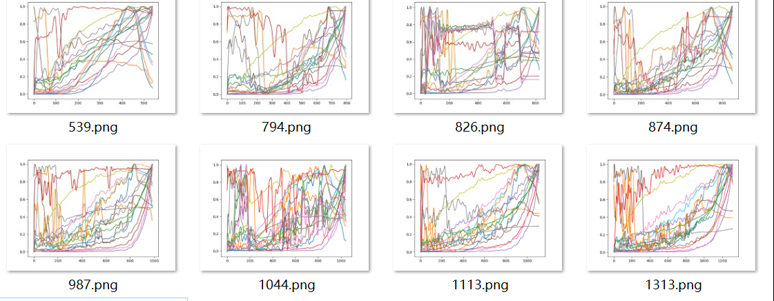
Feature extracted now
Entire 18 features, 12 from capacity and 6 from temperature.

Slide 5
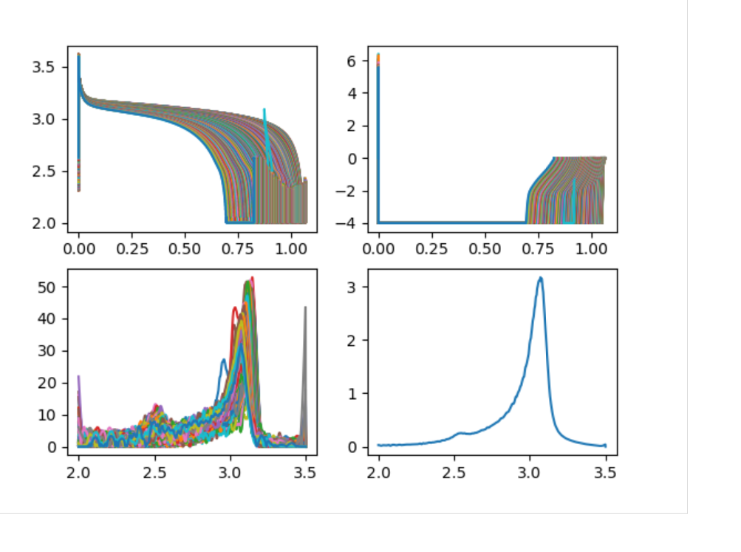
Feature will be added in the future
From SOC-OCV curve, based on polynomial regression.
Inner Resistance
Temperature avg, Temperature min, Temperature max
Entire capacity
Inflection point

Slide 6
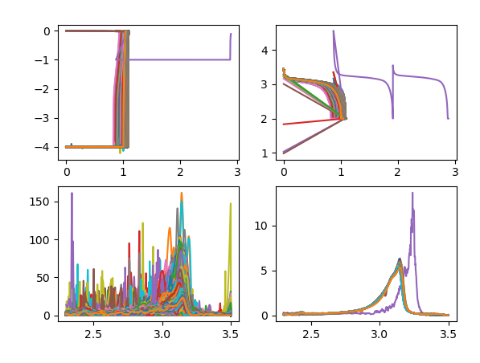
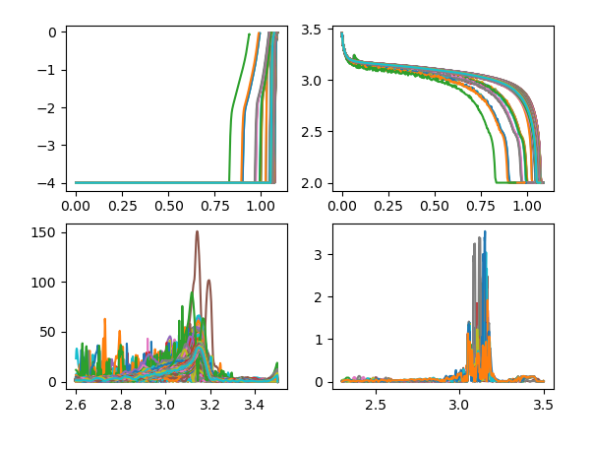
Delete the abnormal cycles

Slide 7
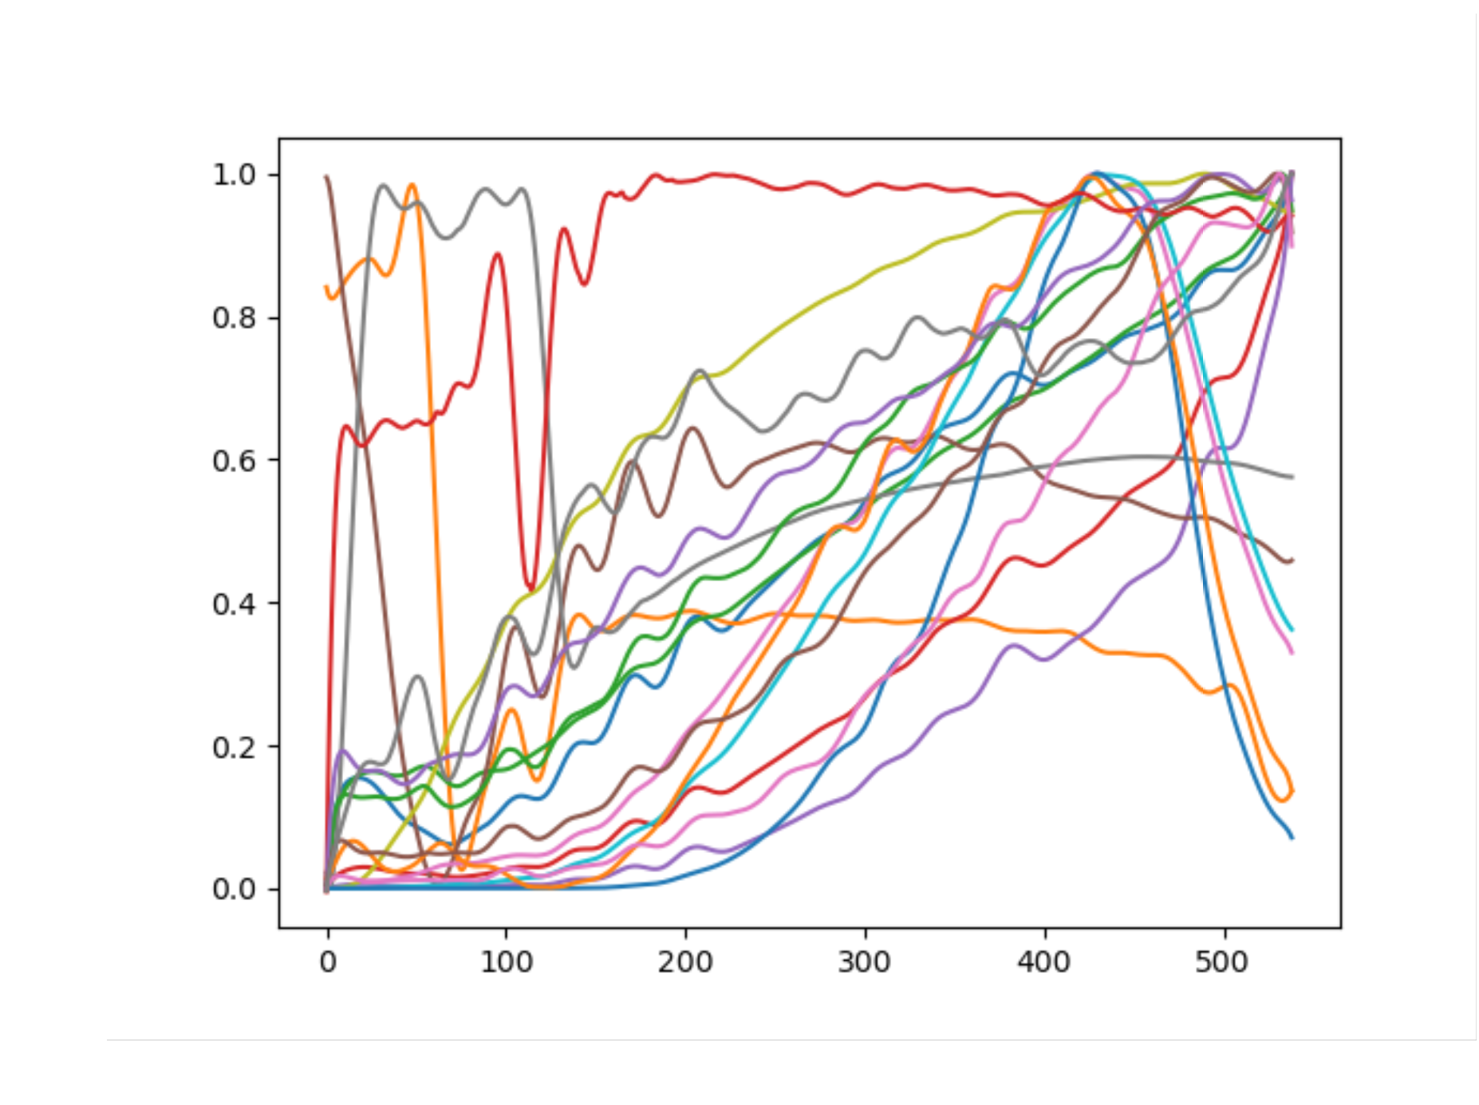
Some changes in training
Input:0 to 250
Label: 539-250=289
Input:100 to 350
Label: 539-350=189

Slide 8

Thank you!

